Slide 1
COMP 224/INTE 216/BBIT 216
COMPUTER ORGANIZATION AND ARCHITECTURE
LECTURE TWO
ARCHITECTURE OF A MICROCOMPUTER SYSTEM
OMBUYA D.O.

Slide 2
Devotional Meditation
1 John 2:20
But you have been anointed by the Holy One, and you all have knowledge.

Slide 3
Lecture Outline
Review of the previous lecture
Item 1 … Definition of Microcomputer
Item 2 … Why study microcomputers
Item 3 … Architecture of a microcomputer
Item 4 … The 8085 microprocessor
Item 5 … Conclusion and wrap up

Slide 4
Definition of a microcomputer
Microcomputer
–Relatively small and inexpensive computer that is contained on one or a few chips.
Microcontroller
–A single-chip microcomputer
Microprocessor
–The processor and control unit part of the single-chip computer(=microcontroller) is called microprocessor.
A single printed circuit board usually connects the ICs, making a computer called a microcomputer

Slide 5
A microcomputer is usually assembled from a microprocessor chip (CPU1) connected to memory chips and I/O (input/output) chips.
A microcomputer is a computer built on the basis of a microprocessor i.e. a processor implemented as an integrated circuit. Since all processors are now produced in the form of integrated circuits, we can say that all computers are microcomputers. The general method for constructing microcomputers consists in connecting to the microprocessor busses additional sub-systems such as memories and peripheral device controllers (input/output units).

Slide 6
Why do we study Microcomputers?
•Embedded systems use microcontrollers or microcomputers.
Some interesting statistics (from a feears ago)
–An average American interacts with 300 or more embedded systems every day.
–95% of all microprocessor will be sold each year for embedded systems.
–IEEE estimated that over 700,000 people worldwide were employed writing code for embedded system in 2007.

Slide 7
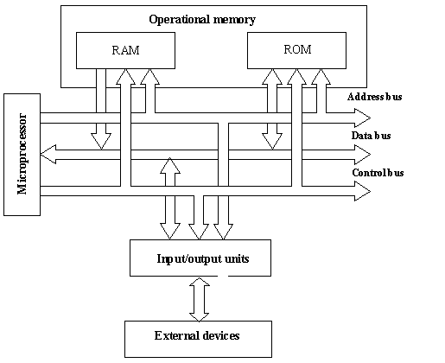
Basic Architecture of microcomputer system

Slide 8
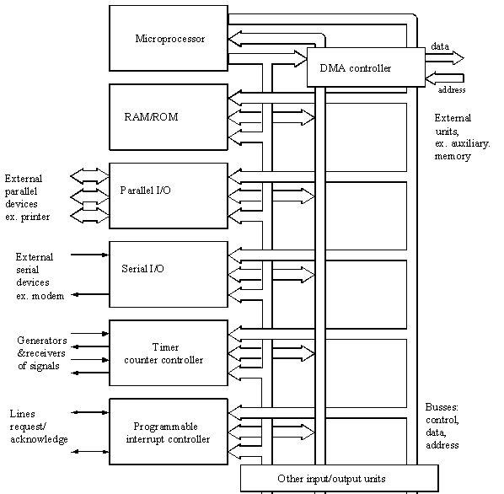
A more developed block diagram of a microcomputer

Slide 9
Besides RAM and ROM memories, more input/output units are connected to the microprocessor.These input/output units include:
parallel input/output controller in short - parallel I/O, parallel interface,
serial input/output controller in short - serial I/O, serial interface,
interrupt controller (handler),
timer/counter controller,
Direct Memory Access (DMA) controller.

Slide 10
Parallel input/output controller maintains information exchange with peripheral devices, which send data in the parallel form. Examples of such devices are printers, display monitor, hard and floppy disk memories, keyboard. The activity of the controller is supervised by the microprocessor, which intervenes on each transfer of data by execution of respective instructions of data read or write from (to) the controller. The controller itself transfers data from its internal memory (registers) to peripheral devices.

Slide 11
The serial input/output controller maintains information exchange with peripheral devices, which send data in the serial form. Examples of such devices are a mouse and a modem for interconnections through telephone network. The controller implements in hardware conversion of serial data into their parallel form and vice versa (with the use of serial/parallel registers). The functioning of the controller is controlled by the microprocessor, which intervenes on each termination of data conversion by execution of respective data read or write instructions.

Slide 12
Interrupt controller provides servicing interrupts coming in parallel from many external devices. Its task consists in receiving interrupt requests, registering them, performing selection to choose one which is to be serviced by the processor. The controller communicates with the processor to enable sending the identifier of the selected interrupt and to exchange control signals. The interrupt controller is supervised by the processor, which services the interrupt after receiving the interrupt from the controller.

Slide 13
The DMA controller enables parallel data exchange between external devices and the operational memory without involvement of the processor. This controller enables autonomous data transfers to/from operational memory. These transfers do not engage the processor, which can proceed with computations at the same time.

Slide 14
The 8085 microprocessor architecture
Generally, the 8085 is an 8-bit microprocessor, and it was launched by Intel team in the year of 1976 with the help of NMOS technology.
Its Configuration:
8-bit data bus
16-bit address bus, which can address upto 64KB
A 16-bit program counter
A 16-bit stack pointer
Six 8-bit registers arranged in pairs: BC, DE, HL
Requires +5V supply to operate at 3.2 MHZ single phase clock
It is used in washing machines, microwave ovens, mobile phones, etc.

Slide 15
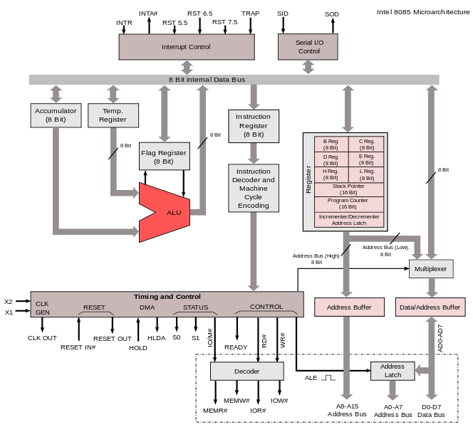

Slide 16
8085 Microprocessor – Functional Units
Accumulator
It is an 8-bit register used to perform arithmetic, logical, I/O & LOAD/STORE operations. It is connected to internal data bus & ALU.
Arithmetic and logic unit
As the name suggests, it performs arithmetic and logical operations like Addition, Subtraction, AND, OR, etc. on 8-bit data.
General purpose register
There are 6 general purpose registers in 8085 processor, i.e. B, C, D, E, H & L. Each register can hold 8-bit data.
These registers can work in pair to hold 16-bit data and their pairing combination is like B-C, D-E & H-L.

Slide 17
Program counter
It is a 16-bit register used to store the memory address location of the next instruction to be executed. Microprocessor increments the program whenever an instruction is being executed, so that the program counter points to the memory address of the next instruction that is going to be executed.
Stack pointer
It is also a 16-bit register works like stack, which is always incremented/decremented by 2 during push & pop operations.
Temporary register
It is an 8-bit register, which holds the temporary data of arithmetic and logical operations.

Slide 18
Flag register
It is an 8-bit register having five 1-bit flip-flops, which holds either 0 or 1 depending upon the result stored in the accumulator.
These are the set of 5 flip-flops −
Sign (S)
Zero (Z)
Auxiliary Carry (AC)
Parity (P)
Carry (C)
Its bit position is shown in the following table −

Slide 19
Instruction register and decoder
It is an 8-bit register. When an instruction is fetched from memory then it is stored in the Instruction register. Instruction decoder decodes the information present in the Instruction register.
Timing and control unit
It provides timing and control signal to the microprocessor to perform operations. Following are the timing and control signals, which control external and internal circuits
Control Signals: READY, RD’, WR’, ALE
Status Signals: S0, S1, IO/M’
DMA Signals: HOLD, HLDA
RESET Signals: RESET IN, RESET OUT

Slide 20
Interrupt control
As the name suggests it controls the interrupts during a process. When a microprocessor is executing a main program and whenever an interrupt occurs, the microprocessor shifts the control from the main program to process the incoming request. After the request is completed, the control goes back to the main program.
There are 5 interrupt signals in 8085 microprocessor: INTR, RST 7.5, RST 6.5, RST 5.5, TRAP.
Serial Input/output control
It controls the serial data communication by using these two instructions: SID (Serial input data) and SOD (Serial output data).

Slide 21
Address buffer and address-data buffer
The content stored in the stack pointer and program counter is loaded into the address buffer and address-data buffer to communicate with the CPU. The memory and I/O chips are connected to these buses; the CPU can exchange the desired data with the memory and I/O chips.
Address bus and data bus
Data bus carries the data to be stored. It is bidirectional, whereas address bus carries the location to where it should be stored and it is unidirectional. It is used to transfer the data & Address I/O devices.

Slide 22
Conclusion
Microcomputers are mainly built from microprocessors
Almost every aspect of the day to day operations of human beings depends on microcomputers

